Slide 1
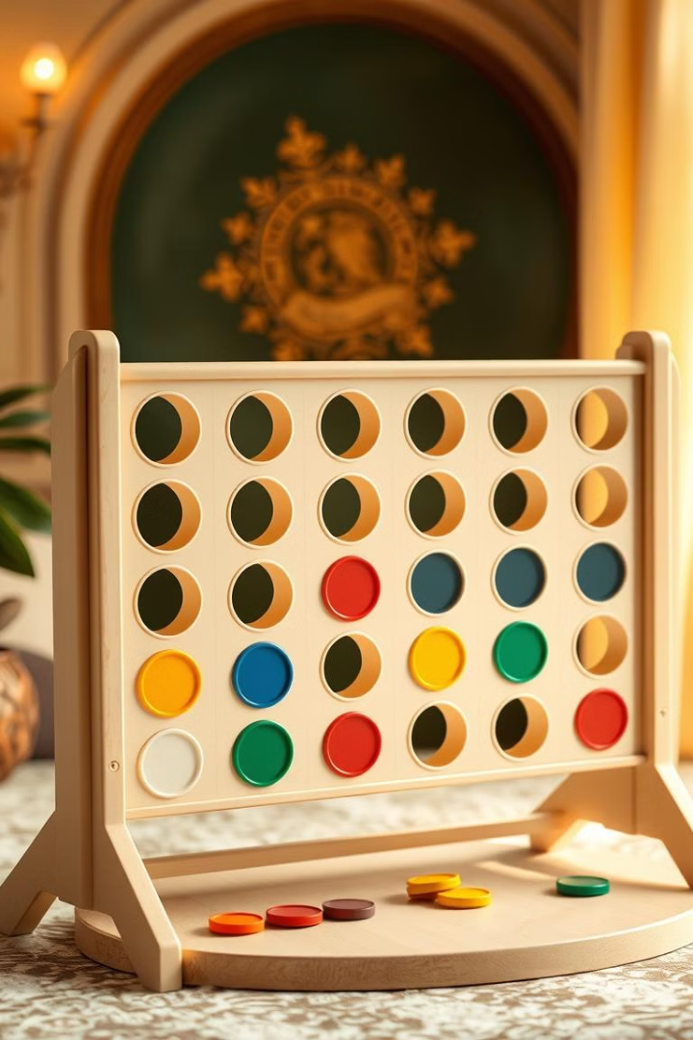
Connect Four Game with Minimax Algorithm: AI vs Player

Slide 2
Overview of Connect Four
The Classic Game
The Goal
Connect Four is a timeless game where two players take turns dropping colored discs into a grid.
The objective is to connect four of your pieces in a row, column, or diagonal. The first player to do so wins.

Slide 3



Introduction to Minimax
1
Game AI
2
Decision Tree
3
Minimax Algorithm

Slide 4
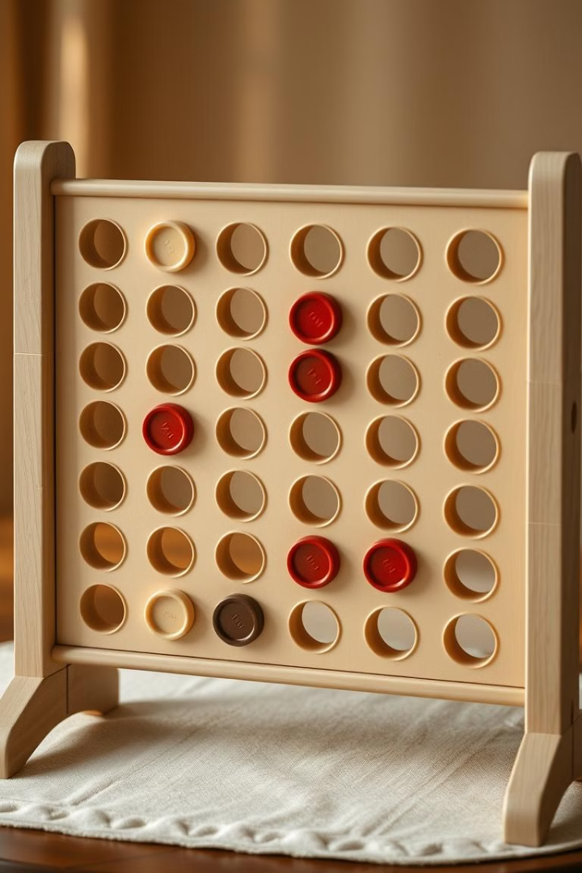
Minimax Principles
1
Maximize Your Score
2
Opponent's Moves
The AI uses Minimax to choose the move that maximizes its own score and minimizes the opponent's score.
Minimax considers all possible moves the opponent could make, and analyzes the potential outcomes.
3
Recursive Evaluation
It recursively explores possible moves and evaluates the board state after each move, considering all potential future scenarios.

Slide 5
Implementing Minimax
1
Game State
2
Evaluate Board
3
Generate Moves
4
Minimax Function

Slide 6




Evaluating Board States
Winning Lines
Opponent's Threats
Strategic Position
The AI assigns higher scores to board states with winning lines, prioritizing moves that lead to a victory.
It evaluates the opponent's potential winning lines, assigning lower scores to moves that increase those threats.
The AI also considers factors like controlling the center column and creating multiple potential winning lines.

Slide 7

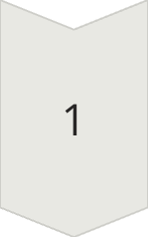
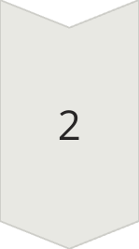
Depth-First Search
Exploration Depth
Minimax uses a depth-first search to explore the decision tree to a certain depth.
Pruning Techniques
To optimize the search, it uses pruning techniques like alpha-beta pruning to cut off branches that are unlikely to lead to better outcomes.

Slide 8
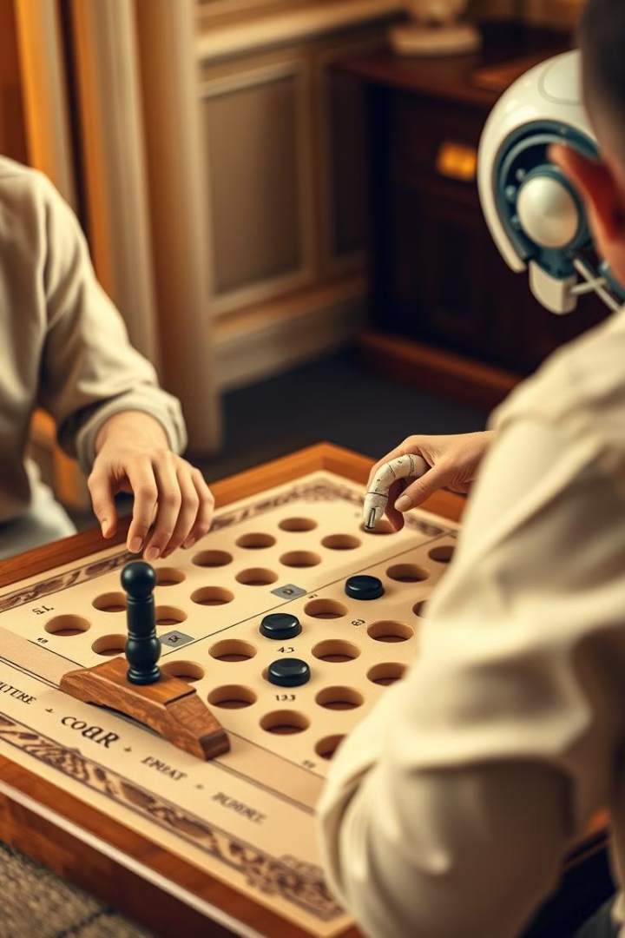
Challenges in Connect Four
Complexity
Incomplete Information
The game has a relatively small number of moves but the decision tree can become large and complex, requiring efficient algorithms.
The AI cannot see all future moves of the opponent. It has to make decisions based on its current knowledge and assumptions.
Strategic Variations
Human players can employ unpredictable strategies, making it challenging for the AI to anticipate all possible moves.

Slide 9
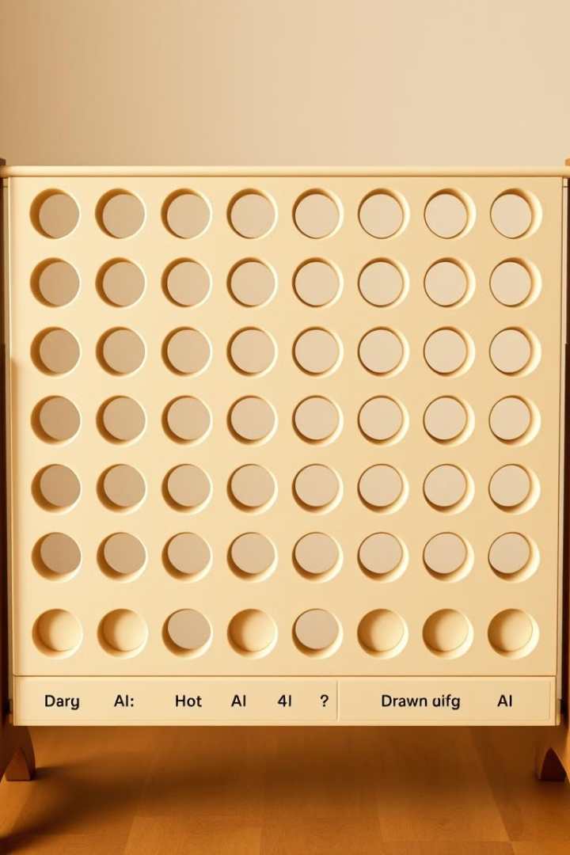
Handling Draw Scenarios
1
Full Board
The game can end in a draw if the board fills up before any player achieves four in a row.
2
AI Detection
The AI is designed to detect draw scenarios and make moves accordingly, avoiding unnecessary moves that lead to a draw.
3
Optimal Strategy
The Minimax algorithm attempts to achieve the best possible outcome for the AI, even if it means accepting a draw rather than losing.

Slide 10
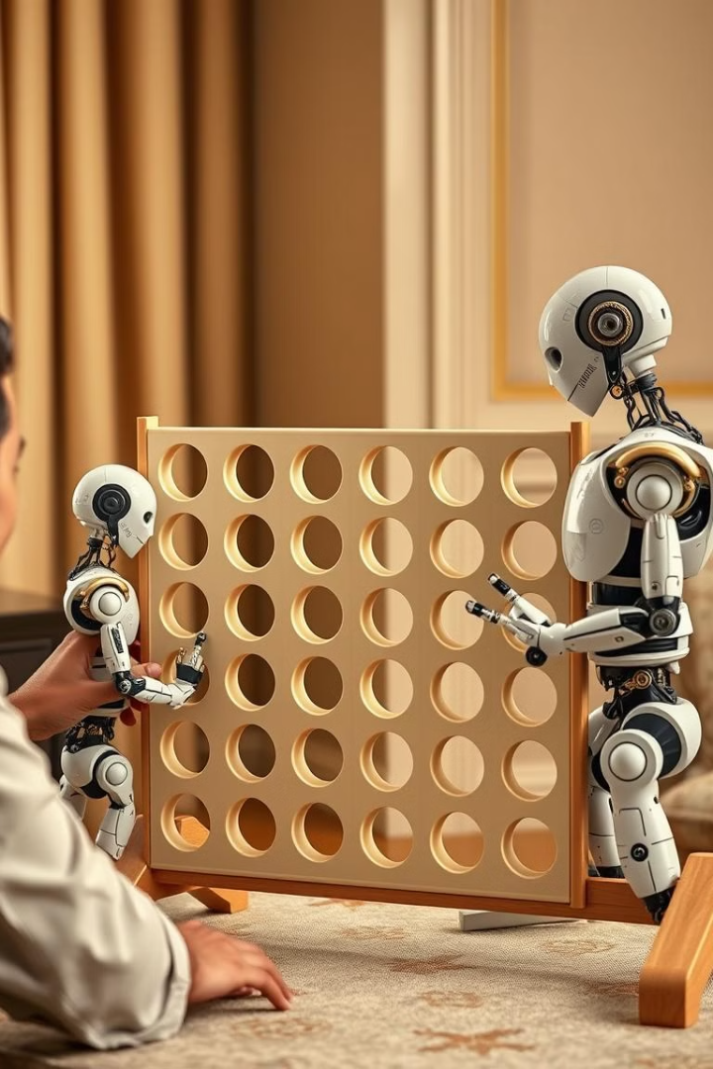
AI vs Human Strategies
1
2
Predictability
Strategic Advantage
AI players tend to be predictable, with their moves often following a logical and consistent pattern.
Minimax-powered AI typically has a significant strategic advantage over human players, especially in the long run.
3
Creativity
Humans can often make creative and unexpected moves that AI might not anticipate.

